Slide 1

CS589-04 Digital Image Processing
Lecture 2. Intensity Transformation and Spatial Filtering
Spring 2008
New Mexico Tech

Slide 2
Spatial Domain vs. Transform Domain
Spatial domain
image plane itself, directly process the intensity values of the image plane
Transform domain
process the transform coefficients, not directly process the intensity values of the image plane

Slide 3
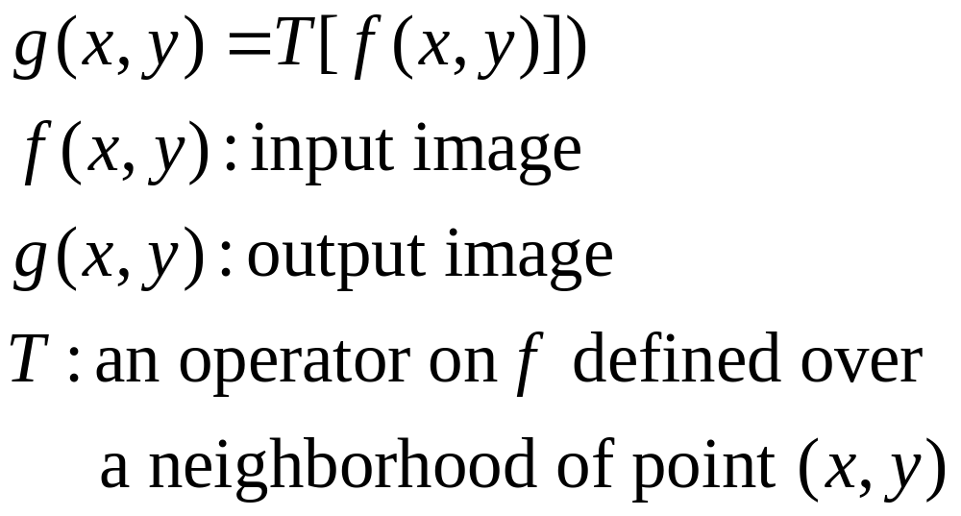
Spatial Domain Process

Slide 4
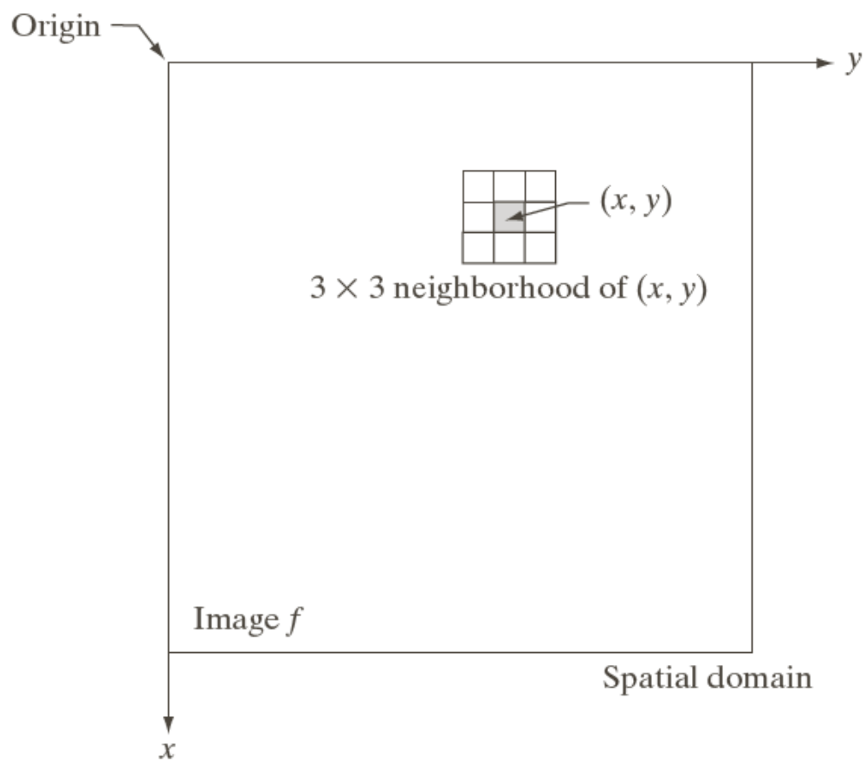
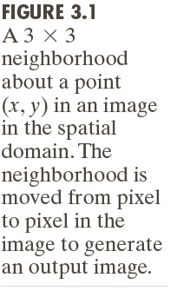
Spatial Domain Process

Slide 5
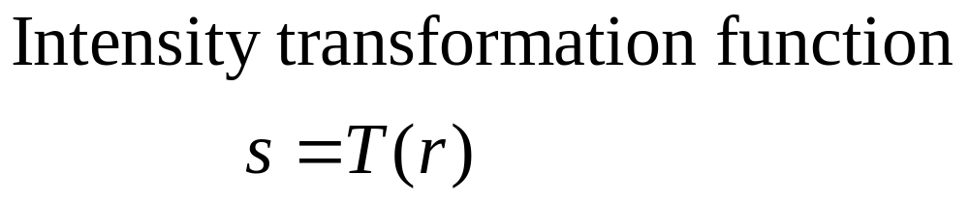
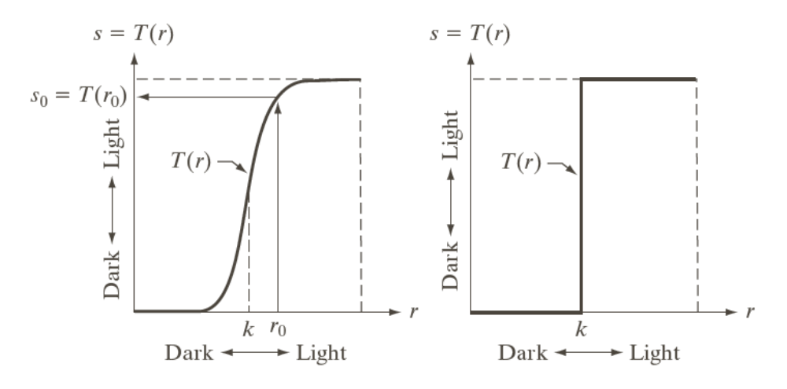
Spatial Domain Process

Slide 6
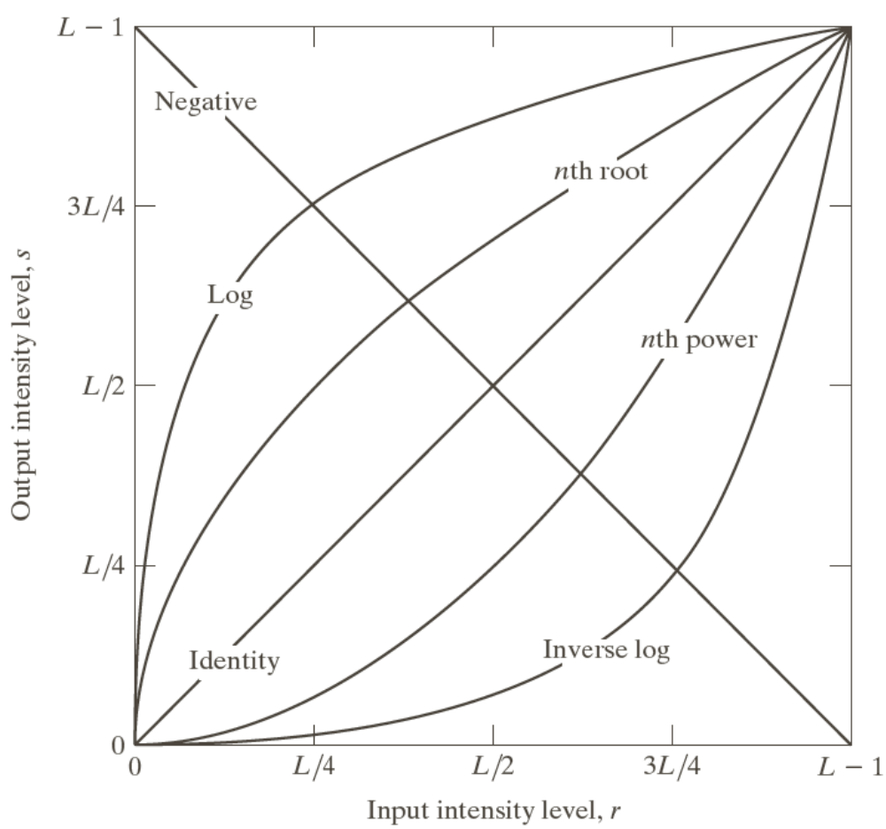
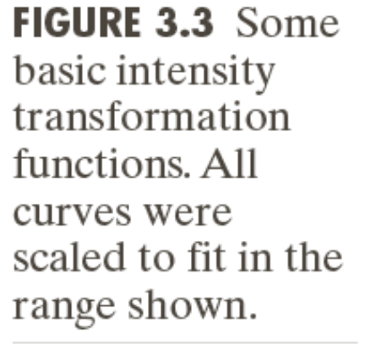
Some Basic Intensity Transformation Functions

Slide 7
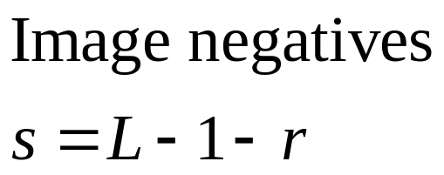
Image Negatives

Slide 8
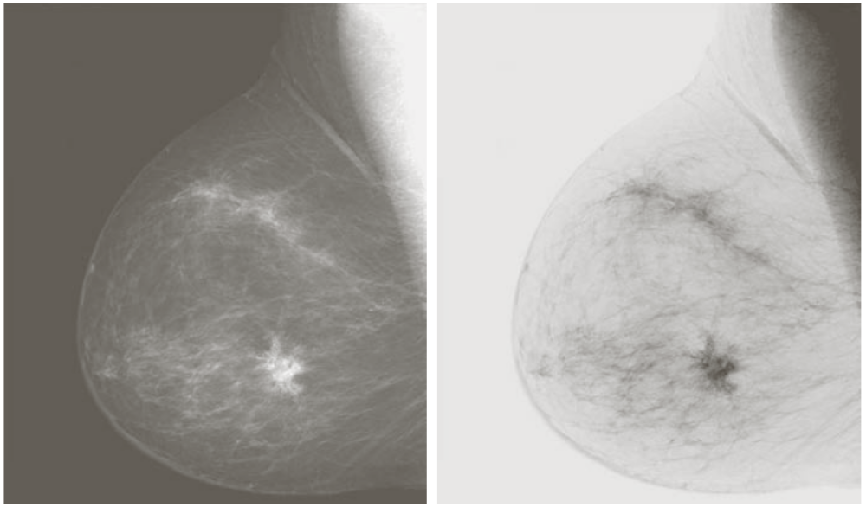
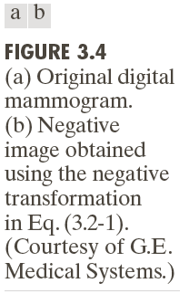
Example: Image Negatives
Small lesion

Slide 9
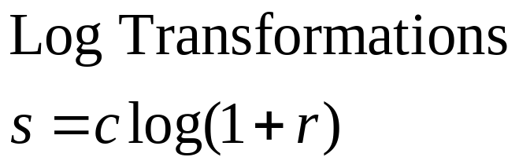
Log Transformations

Slide 10
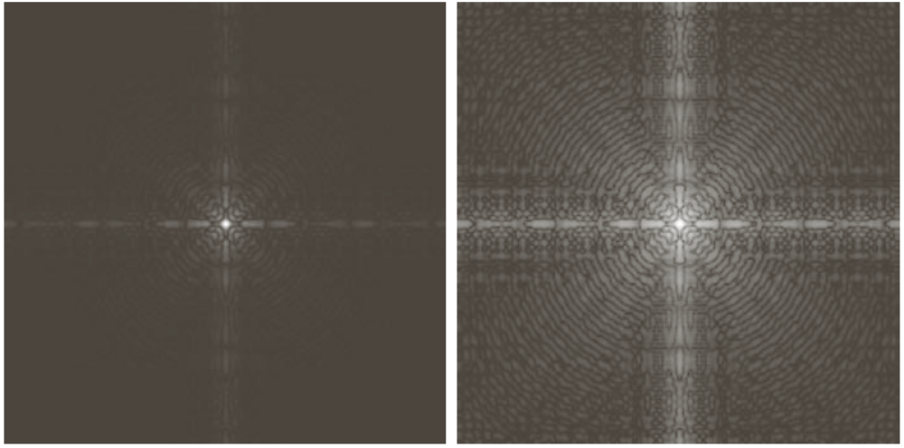
Example: Log Transformations

Slide 11
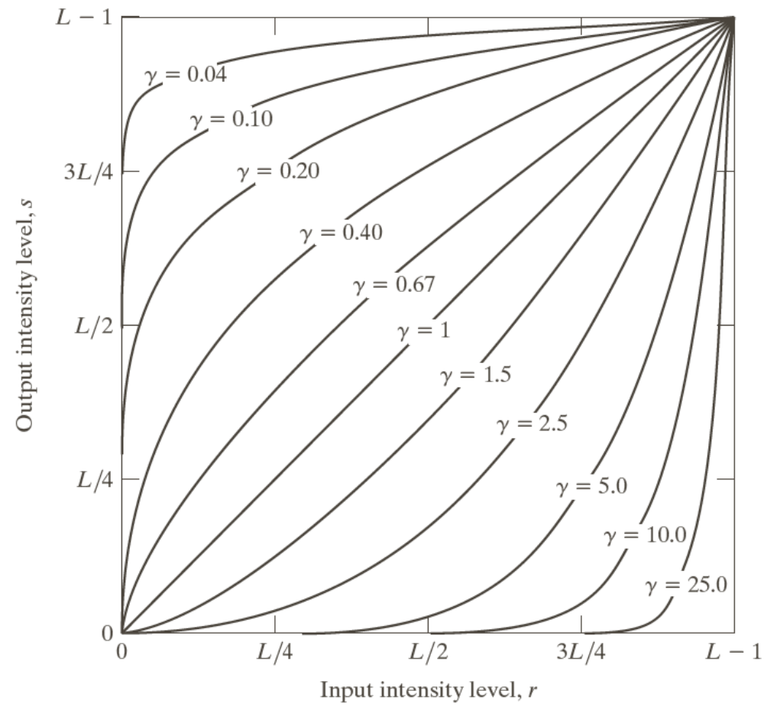
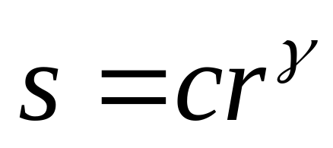
Power-Law (Gamma) Transformations

Slide 12
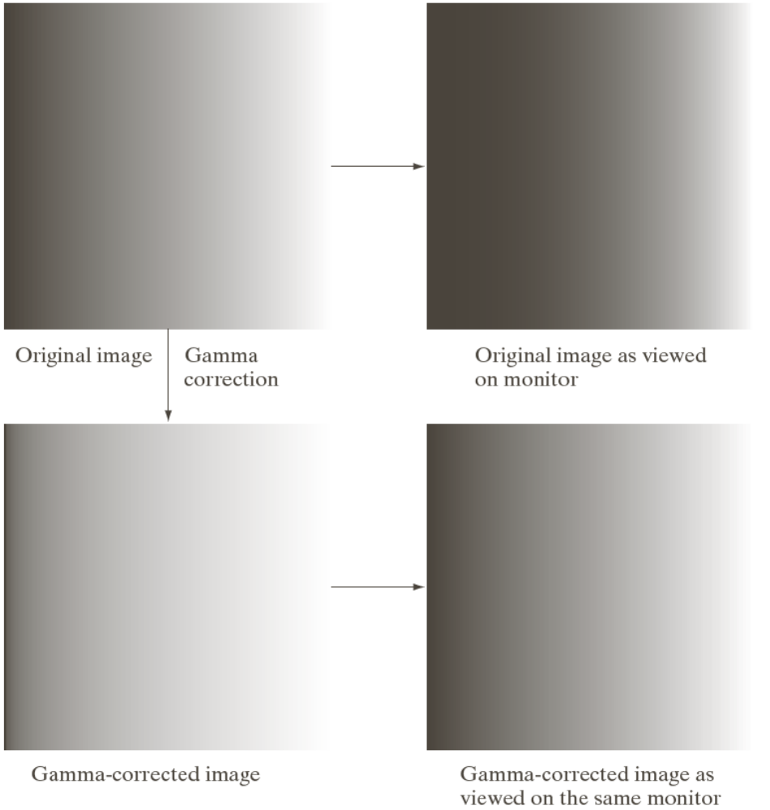
Example: Gamma Transformations

Slide 13
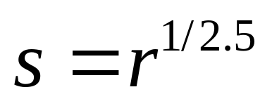
Example: Gamma Transformations
Cathode ray tube (CRT) devices have an intensity-to-voltage response that is a power function, with exponents varying from approximately 1.8 to 2.5

Slide 14
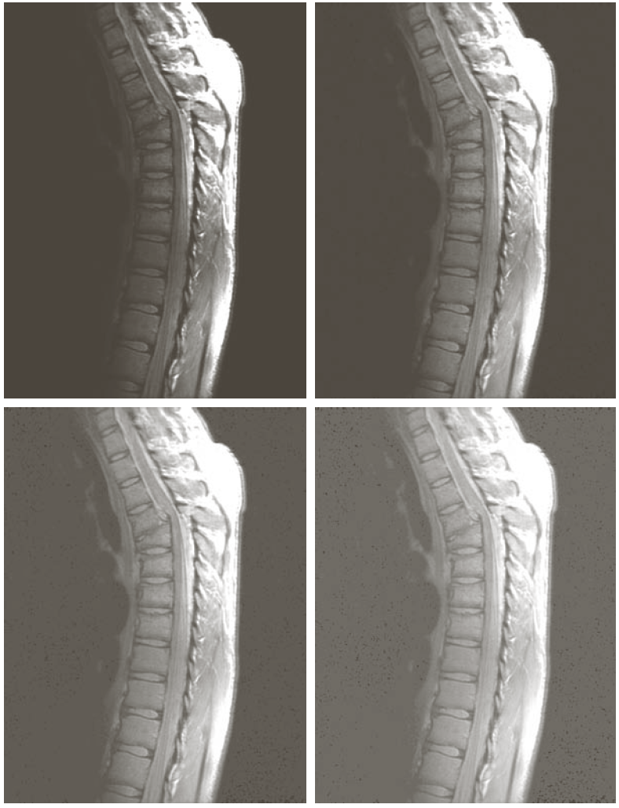
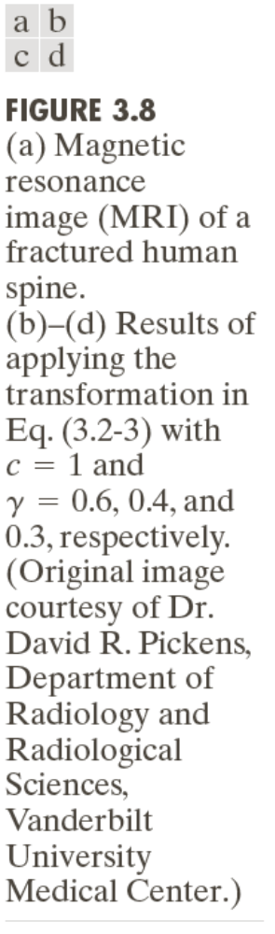
Example: Gamma Transformations

Slide 15
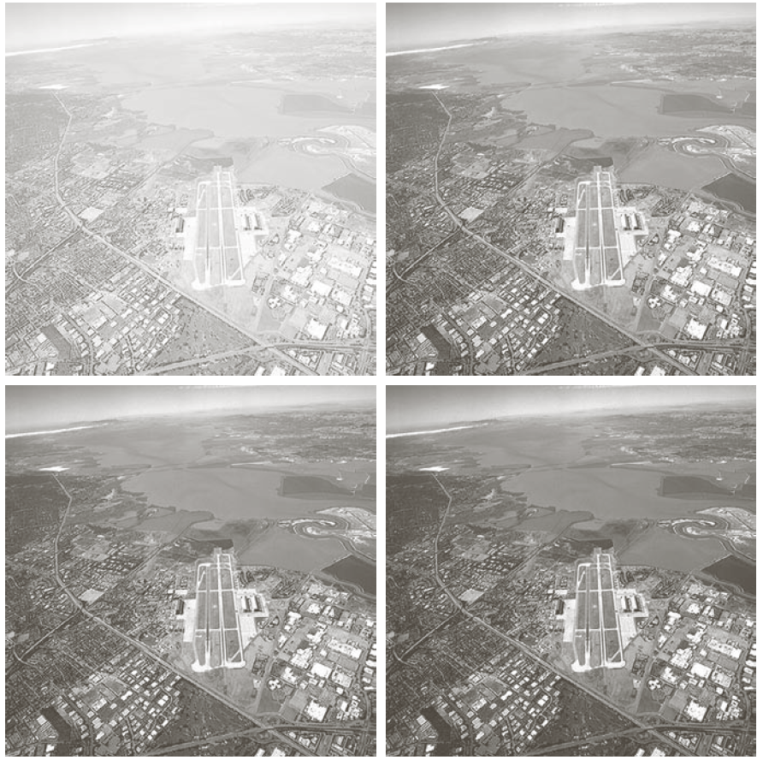
Example: Gamma Transformations

Slide 16
Piecewise-Linear Transformations
Contrast Stretching
— Expands the range of intensity levels in an image so that it spans the full intensity range of the recording medium or display device.
Intensity-level Slicing
— Highlighting a specific range of intensities in an image often is of interest.

Slide 17
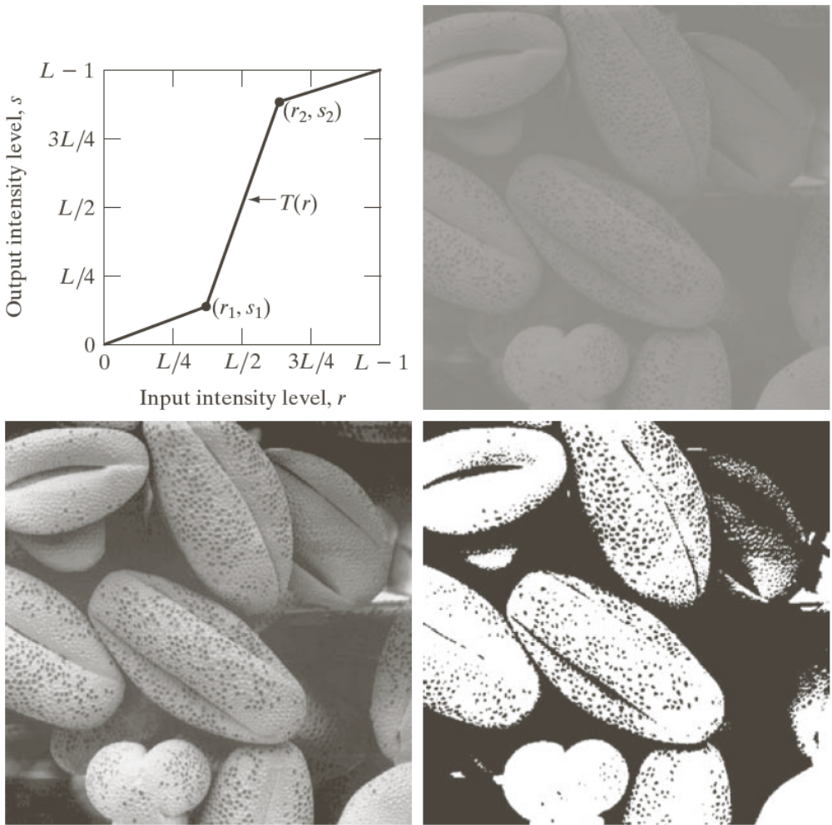
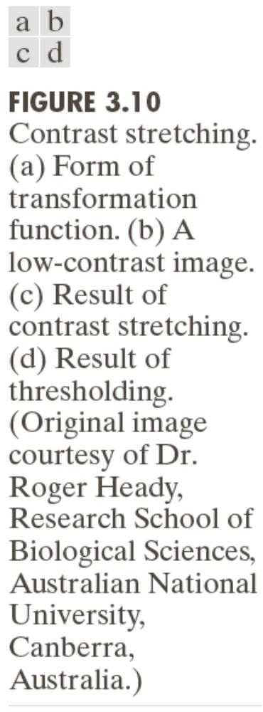

Slide 18
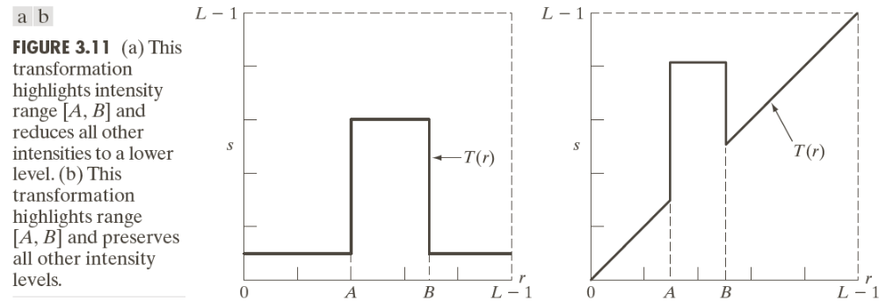
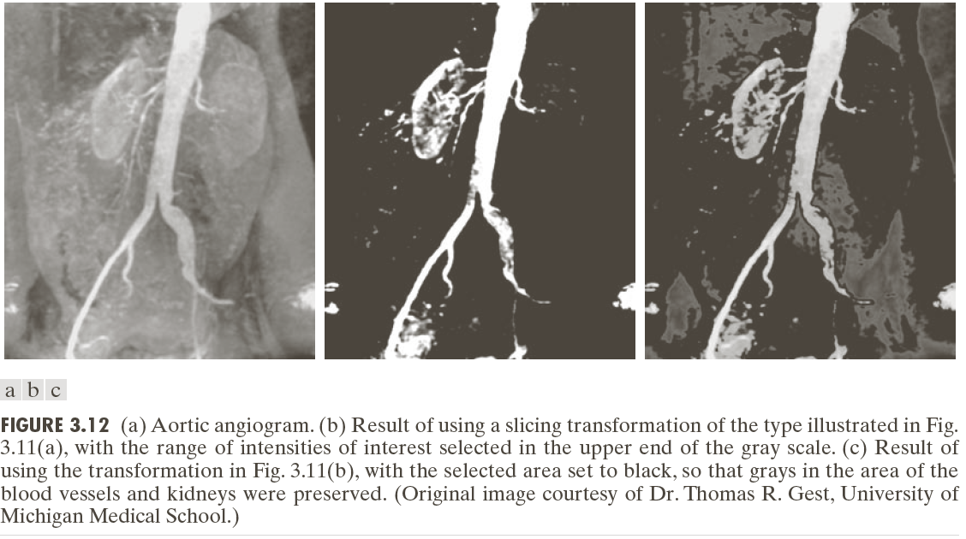
Highlight the major blood vessels and study the shape of the flow of the contrast medium (to detect blockages, etc.)
Measuring the actual flow of the contrast medium as a function of time in a series of images

Slide 19
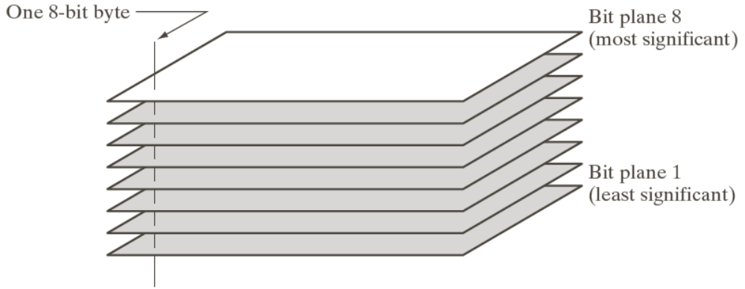
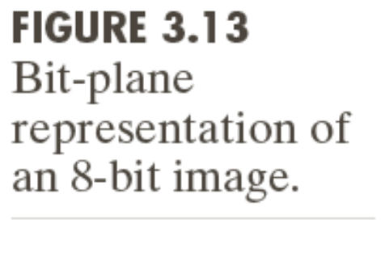
Bit-plane Slicing

Slide 20
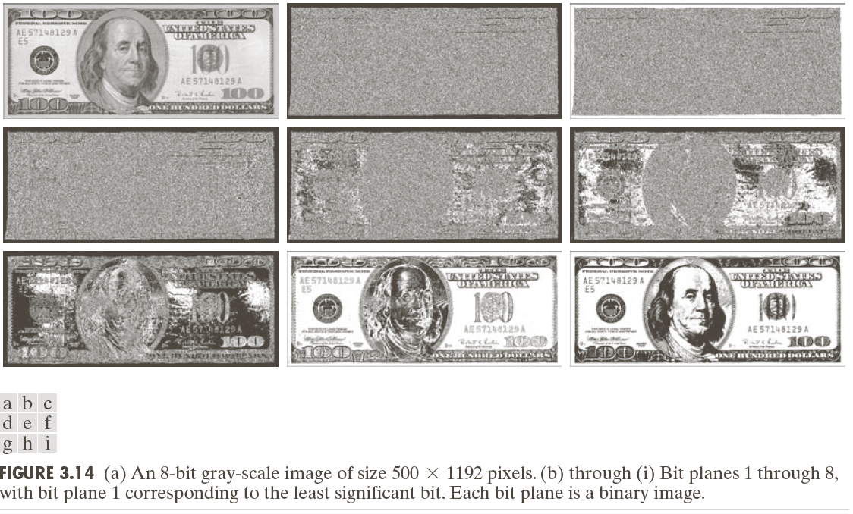
Bit-plane Slicing

Slide 21
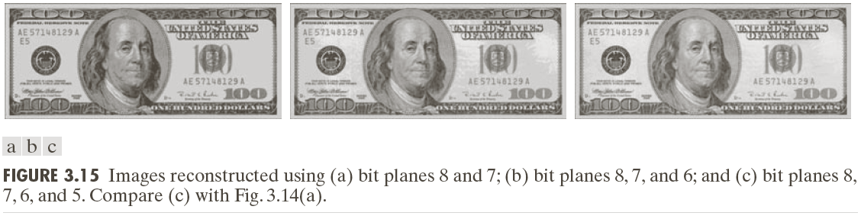
Bit-plane Slicing

Slide 22
Histogram Processing
Histogram Equalization
Histogram Matching
Local Histogram Processing
Using Histogram Statistics for Image Enhancement

Slide 23
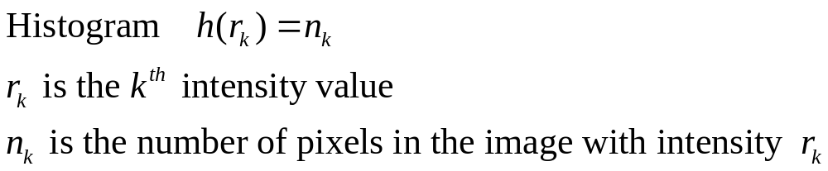
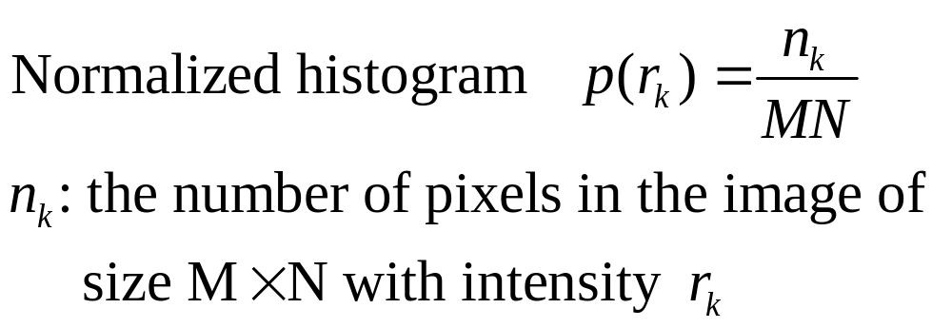
Histogram Processing

Slide 24
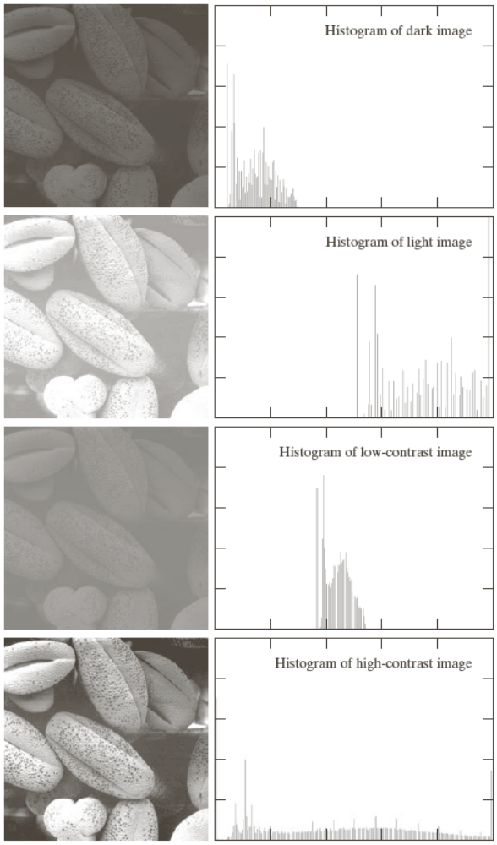

Slide 25
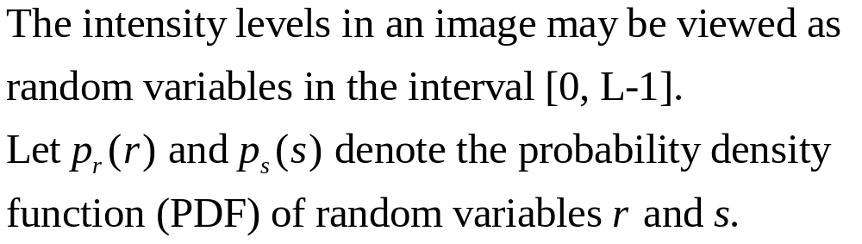
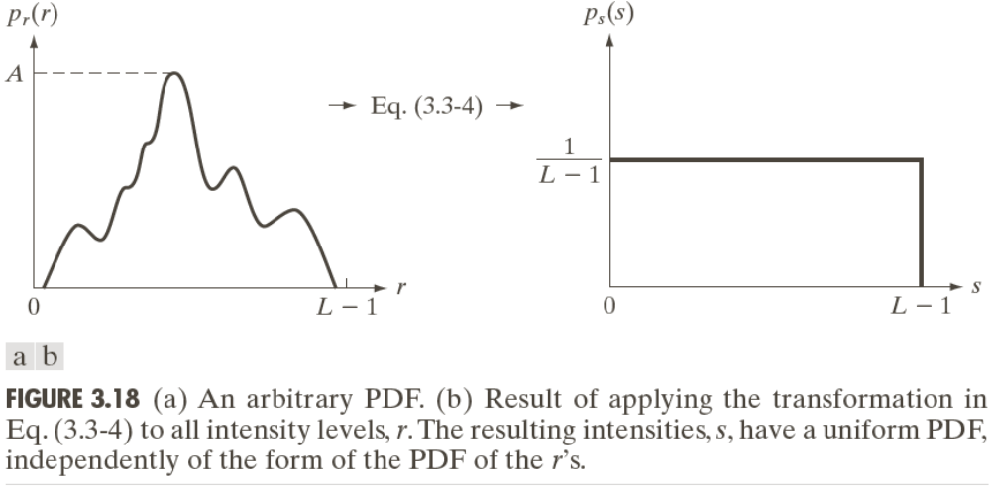
Histogram Equalization

Slide 26

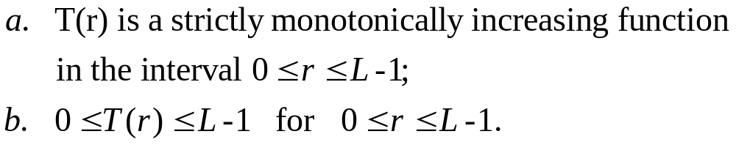
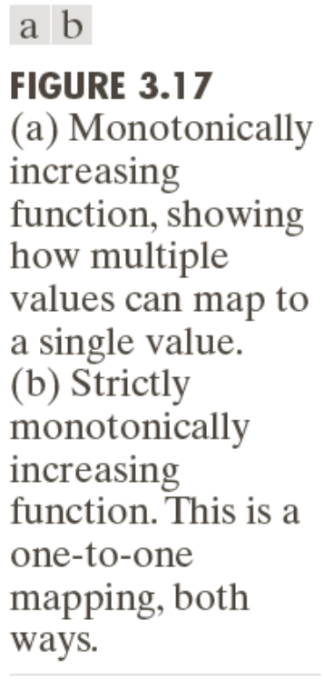
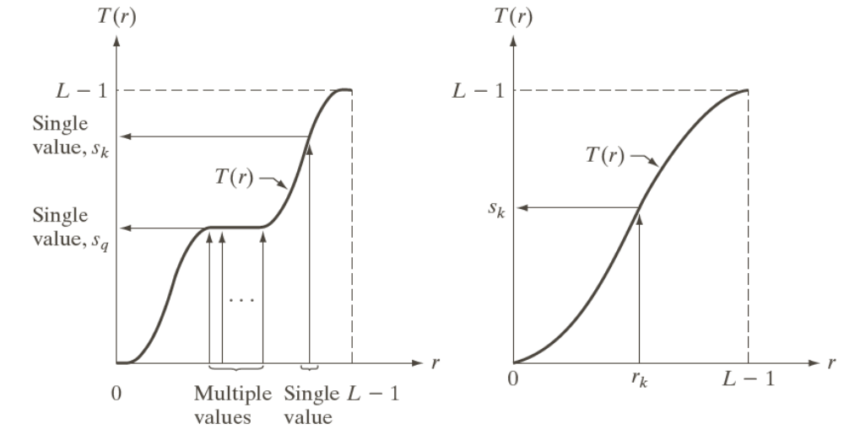
Histogram Equalization

Slide 27
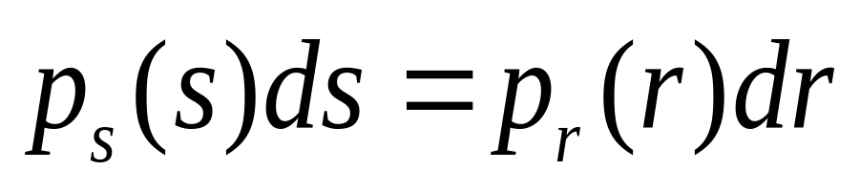
Histogram Equalization

Slide 28
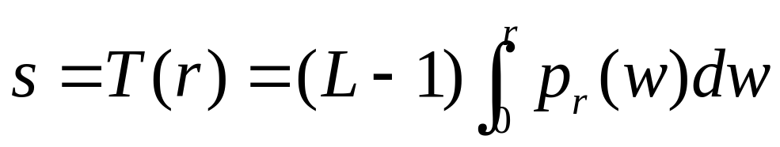
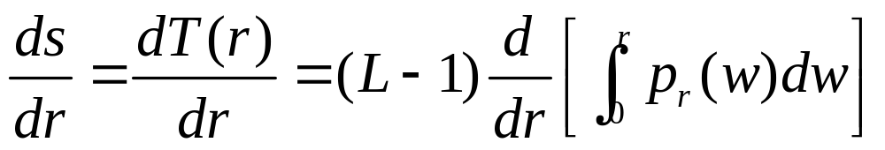
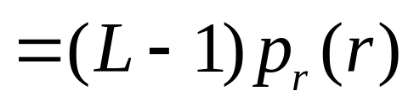
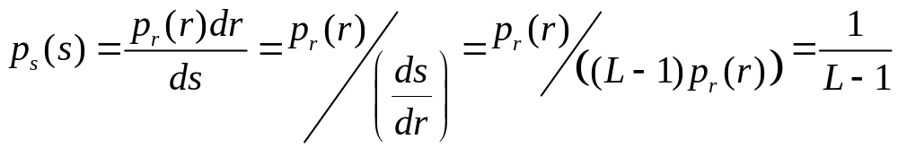
Histogram Equalization

Slide 29
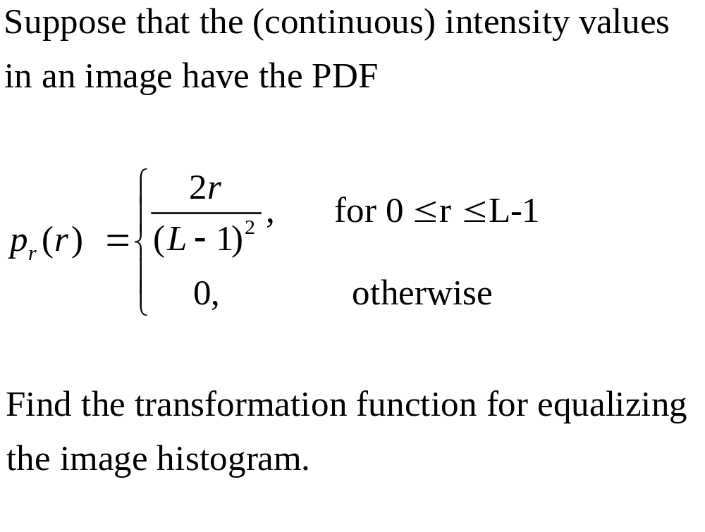
Example

Slide 30

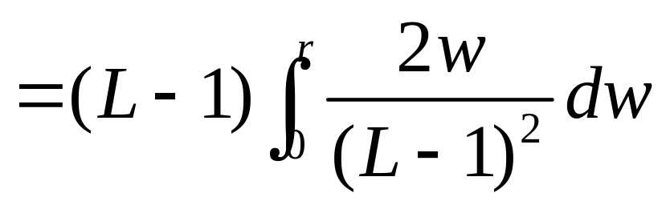
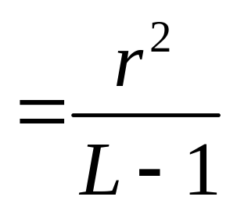
Example

Slide 31
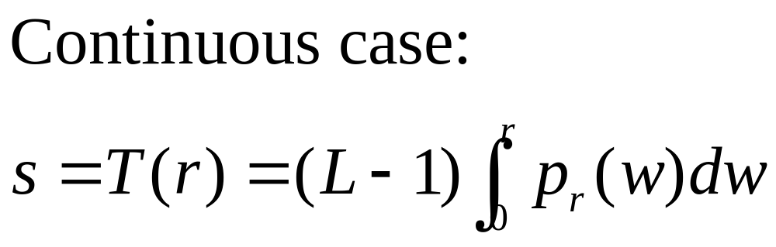
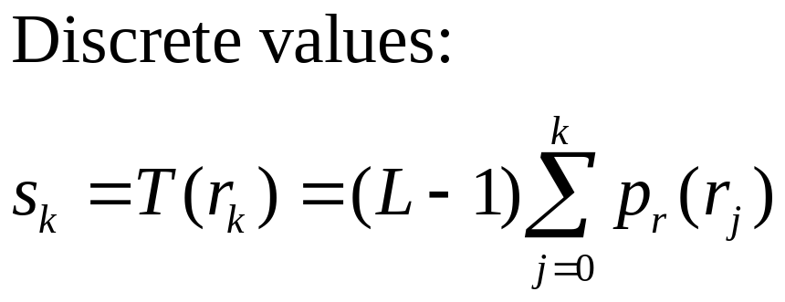
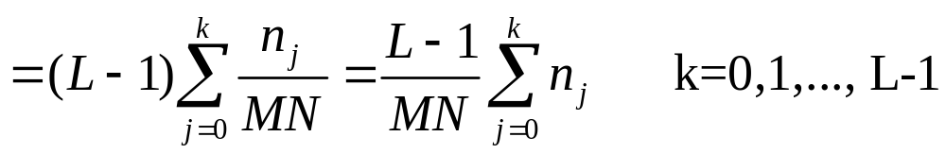
Histogram Equalization

Slide 32
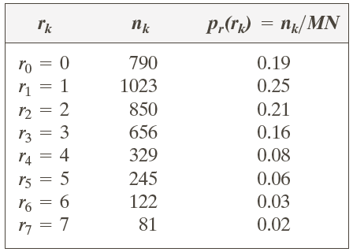
Example: Histogram Equalization
Suppose that a 3-bit image (L=8) of size 64 × 64 pixels (MN = 4096) has the intensity distribution shown in following table.
Get the histogram equalization transformation function and give the p_{s}(s_{k}) for each s_{k}.

Slide 33
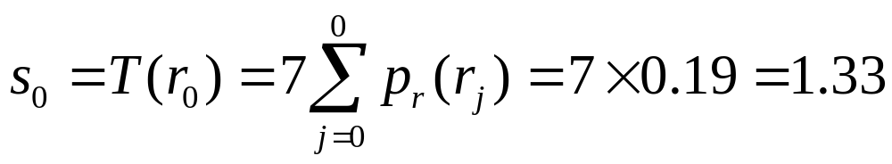
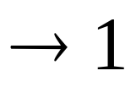
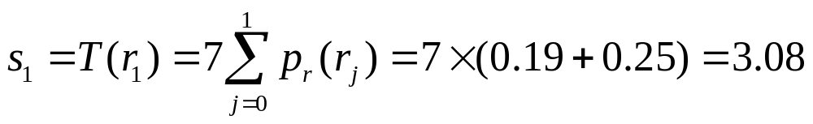


Example: Histogram Equalization

Slide 34

Example: Histogram Equalization

Slide 35


Slide 36


Slide 37
Question
Is histogram equalization always good?
No

Slide 38

Histogram Matching
Histogram matching (histogram specification)
— generate a processed image that has a specified histogram

Slide 39


Histogram Matching

Slide 40



Histogram Matching: Procedure
Obtain p_{r}(r) from the input image and then obtain the values of s
Use the specified PDF and obtain the transformation function G(z)
Mapping from s to z

Slide 41


Histogram Matching: Example
Assuming continuous intensity values, suppose that an image has the intensity PDF
Find the transformation function that will produce an image whose intensity PDF is

Slide 42




Histogram Matching: Example
Find the histogram equalization transformation for the input image
Find the histogram equalization transformation for the specified histogram
The transformation function

Slide 43



Histogram Matching: Discrete Cases
Obtain p_{r}(r_{j}) from the input image and then obtain the values of s_{k}, round the value to the integer range [0, L-1].
Use the specified PDF and obtain the transformation function G(z_{q}), round the value to the integer range [0, L-1].
Mapping from s_{k} to z_{q}

Slide 44

Example: Histogram Matching
Suppose that a 3-bit image (L=8) of size 64 × 64 pixels (MN = 4096) has the intensity distribution shown in the following table (on the left). Get the histogram transformation function and make the output image with the specified histogram, listed in the table on the right.

Slide 45











Example: Histogram Matching
Obtain the scaled histogram-equalized values,
Compute all the values of the transformation function G,

Slide 46


Example: Histogram Matching

Slide 47
Example: Histogram Matching
Obtain the scaled histogram-equalized values,
Compute all the values of the transformation function G,
s₀
s₁
s₂
s₃
s₄
s₅
s₆
s₇

Slide 48

Example: Histogram Matching

Slide 49

Example: Histogram Matching

Slide 50


Example: Histogram Matching

Slide 51


Example: Histogram Matching

Slide 52


Example: Histogram Matching

Slide 53
Local Histogram Processing
Define a neighborhood and move its center from pixel to pixel
At each location, the histogram of the points in the neighborhood is computed. Either histogram equalization or histogram specification transformation function is obtained
Map the intensity of the pixel centered in the neighborhood
Move to the next location and repeat the procedure

Slide 54

Local Histogram Processing: Example

Slide 55





Using Histogram Statistics for Image Enhancement
Average Intensity
Variance

Slide 56


Using Histogram Statistics for Image Enhancement

Slide 57


Using Histogram Statistics for Image Enhancement: Example

Slide 58

Spatial Filtering
A spatial filter consists of (a) a neighborhood, and (b) a predefined operation
Linear spatial filtering of an image of size MxN with a filter of size mxn is given by the expression

Slide 59

Spatial Filtering

Slide 60


Spatial Correlation

Slide 61


Spatial Convolution

Slide 62



Slide 63
Smoothing Spatial Filters
Smoothing filters are used for blurring and for noise reduction
Blurring is used in removal of small details and bridging of small gaps in lines or curves
Smoothing spatial filters include linear filters and nonlinear filters.

Slide 64

Spatial Smoothing Linear Filters

Slide 65


Two Smoothing Averaging Filter Masks

Slide 66



Slide 67


Example: Gross Representation of Objects

Slide 68
Order-statistic (Nonlinear) Filters
— Nonlinear
— Based on ordering (ranking) the pixels contained in the filter mask
— Replacing the value of the center pixel with the value determined by the ranking result
E.g., median filter, max filter, min filter

Slide 69

Example: Use of Median Filtering for Noise Reduction

Slide 70
Sharpening Spatial Filters
Foundation
Laplacian Operator
Unsharp Masking and Highboost Filtering
Using First-Order Derivatives for Nonlinear Image Sharpening — The Gradient

Slide 71


Sharpening Spatial Filters: Foundation
The first-order derivative of a one-dimensional function f(x) is the difference
The second-order derivative of f(x) as the difference

Slide 72



Slide 73




Sharpening Spatial Filters: Laplace Operator
The second-order isotropic derivative operator is the Laplacian for a function (image) f(x,y)

Slide 74


Sharpening Spatial Filters: Laplace Operator

Slide 75

Sharpening Spatial Filters: Laplace Operator
Image sharpening in the way of using the Laplacian:

Slide 76



Slide 77
Unsharp Masking and Highboost Filtering
Unsharp masking
Sharpen images consists of subtracting an unsharp (smoothed) version of an image from the original image
e.g., printing and publishing industry
Steps
1. Blur the original image
2. Subtract the blurred image from the original
3. Add the mask to the original

Slide 78

Unsharp Masking and Highboost Filtering

Slide 79


Unsharp Masking: Demo

Slide 80


Unsharp Masking and Highboost Filtering: Example

Slide 81


Image Sharpening based on First-Order Derivatives
Gradient Image

Slide 82


Image Sharpening based on First-Order Derivatives
z₁ | z₂ | z₃
z₄ | z₅ | z₆
z₇ | z₈ | z₉

Slide 83


Image Sharpening based on First-Order Derivatives
z₁ | z₂ | z₃
z₄ | z₅ | z₆
z₇ | z₈ | z₉

Slide 84


Image Sharpening based on First-Order Derivatives

Slide 85

Example

Slide 86


Example:
Combining Spatial Enhancement Methods
Goal:
Enhance the image by sharpening it and by bringing out more of the skeletal detail

Slide 87


Example:
Combining Spatial Enhancement Methods
Goal:
Enhance the image by sharpening it and by bringing out more of the skeletal detail

